Slide 1
How was your day?
Fine.
Notes:
Parenting Grad School

Slide 2
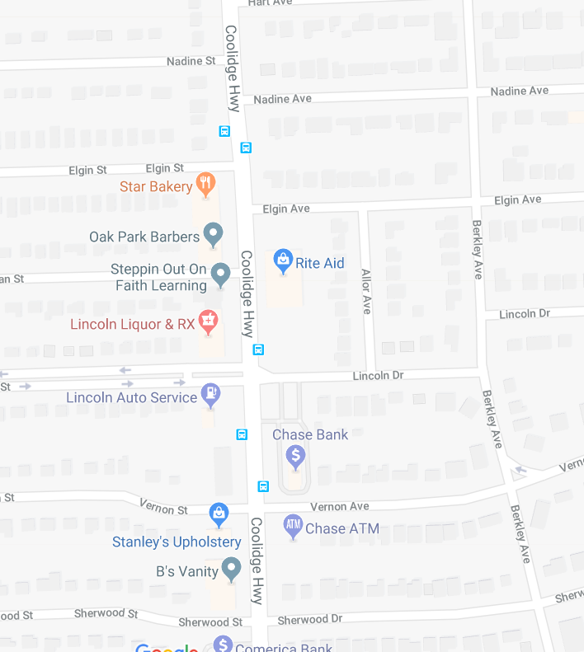
Getting There Is Half The Battle
Know the route
Have a buddy
Walkers
Lincoln & Berkley
Bikers
Helmet
Traffic Laws
Bike Lock
Store Etiquette
Stranger Danger

Slide 3
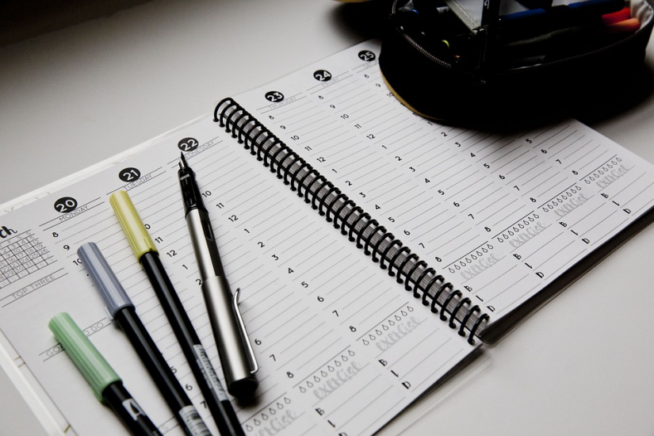
They’ve Arrived: Logistical Challenges
Changing classes with up to 6 different teachers
Larger environment (Approximately 750 students)
Increased rigor with coursework
Executive Functioning
Organization
Time Management
More Homework
Follow-thru
Notes:
Don't ever be afraid to ask teachers and administrators for help. Ask again if you don't get a response right away.

Slide 4
Personal Challenges
Puberty
Skin
Body odor
Menstruation
Body Image
Size
Weight
Mental Health
Anxiety – 25% *
Depression – 10 %*
Backpack
Hygiene
Kit
Healthy Choices
Start the Conversation
*Pew Research Center
Notes:
Free Fall – out of control, yet excited
Experience frustration with conflicting emotions, awkward body growth, incomplete thinking patterns
Joy, rage and despair

Slide 5
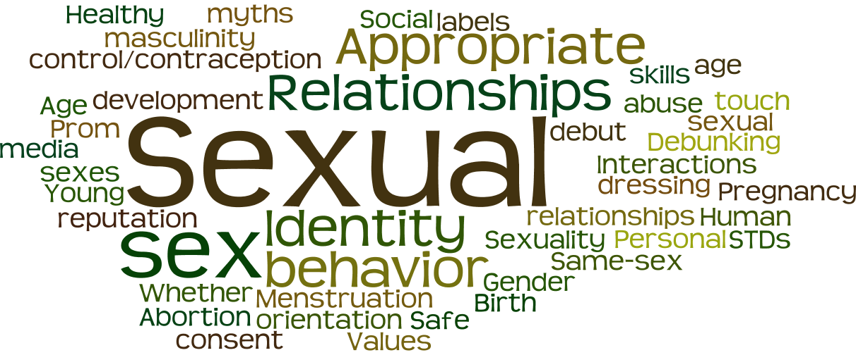
Personal safety
Gender and Preference Exploration
Sexual Contact
Consensual
Non-consensual (assault)
Healthy Relationships
Realistic Expectations
12% of female teens reported physical violence
16% reported sexual violence from a dating partner
7% of male teens reported physical violence
5% reported sexual violence from a dating partner
*Center for Disease Control and Prevention
Notes:
Youth who experience dating violence are more likely to:
Experience symptoms of depression and anxiety
Engage in unhealthy behaviors, such as using tobacco, drugs, and alcohol
Exhibit antisocial behaviors
Think about suicide
Be on the same page with your parenting partner

Slide 6
Final Thoughts
Changing thoughts
Changing values
United you stand, divided you fall
Not your business
No guilt
For most kids, middle school is not a perfect experience and it is often very challenging. Your children will experience adversity, challenges, and social issues in middle school. Children are changing into mini adults and they will do some frustrating things; It's unavoidable.
Notes:
Elem school = like telling us things. Adolescence = they have a lot of thoughts they can’t articulate - I wonder if my mom can handle what I’m thinking about, maybe I shouldn’t tell her
Explore different value systems and worry about sharing thoughts that don’t fit with parents value system
Parenting partner and you need a united front on discipline, ok to regroup and revisit
Let them know you’re there and will help without judgment
No one sets out to be a bad parent, we all do our best, marathon not a sprint, let the guilt go
Stay woke and coach them through!

Slide 7
JUUL

Slide 8
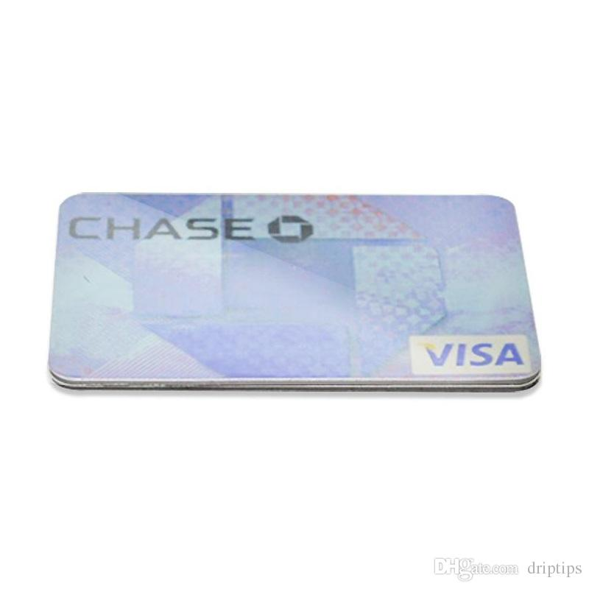
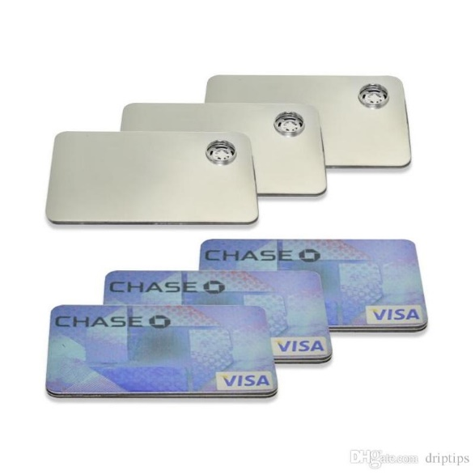
Vape Device

Slide 9
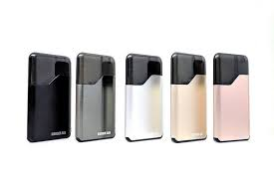
Vape Device

Slide 10
Vape Device

Slide 11
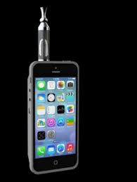
Vape Device

Slide 12
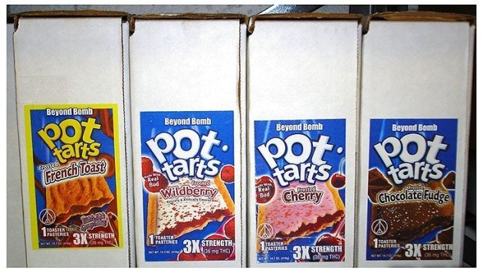
THC Edibles

Slide 13
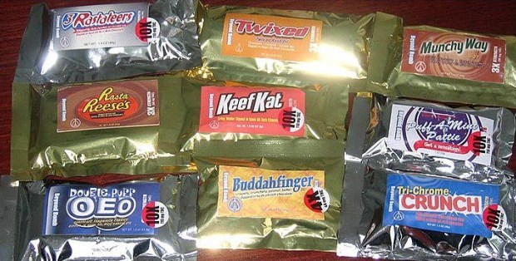
THC Edibles

Slide 14
THC Edibles

Slide 15
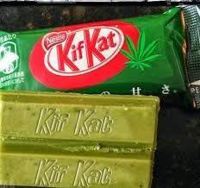
THC Edibles

Slide 16
More Information
Text “@hk9698” to 81010 to receive information about future parenting events

